Slide 1
24-HOUR National Level Shridevi Hackathon
Earthquake Detection AND ALERT SYSTEM

Slide 2
INDEX
 | INTRODUCTION
 | Causes of Earthquake:
 | Hardware components
 | COMPONENT OVERVIEW
 | BENEFITS
 | CONCLUSION

Slide 3
introduction
Earthquakes are sudden, rapid shaking of the Earth caused by the release of energy stored in rocks due to tectonic forces. This energy release happens along faults, and fractures in the Earth’s crust where rock sections move against each other. The severity of an earthquake is measured by magnitude and intensity; magnitude represents the energy released, while intensity describes the earthquake's effects on the Earth's surface and human structures.
Earthquakes are natural phenomena with destructive potential, but through preparedness, strong infrastructure, and timely response, societies can reduce their impact.

Slide 4
Causes of Earthquake
Tectonic Plate Movement:
Plate Boundaries: The Earth's crust is divided into several large and small tectonic plates. These plates can interact with each other at their boundaries, leading to various types of earthquakes.
Convergent Boundaries: Plates move toward each other, causing one plate to be forced beneath another (subduction). This can lead to powerful earthquakes.
Divergent Boundaries: Plates move apart, allowing magma to rise and create new crust. Earthquakes can occur here as the crust fractures.

Slide 5
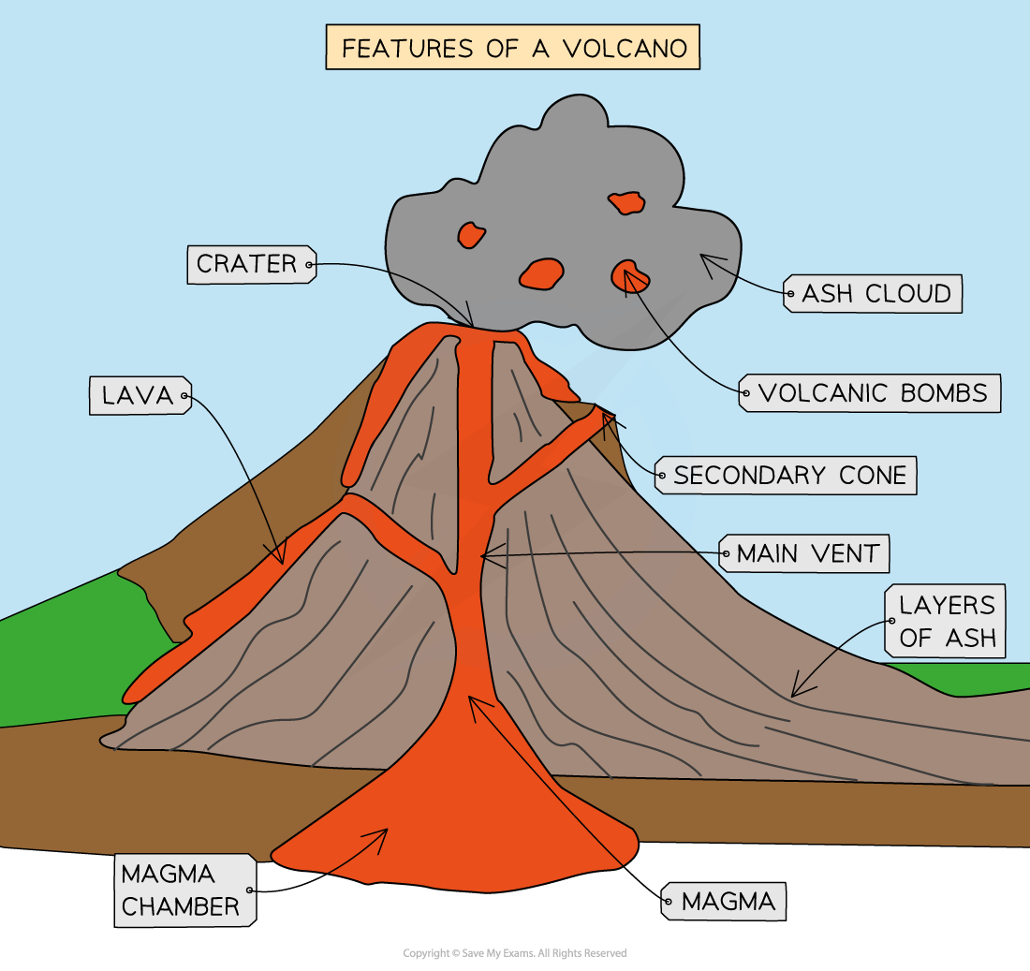
Volcanic Activity
Volcanic Earthquakes: Caused by the movement of magma underground. These can occur before, during, and after an eruption.
Tectonic Earthquakes: Generally, occur due to the movement of tectonic plates, and can also trigger volcanic eruptions.

Slide 6
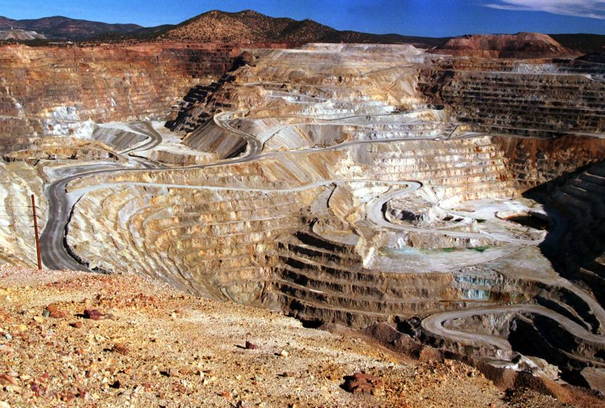
Human activity
Some human activities, like mining, reservoir-induced seismicity (caused by large reservoirs behind dams), and hydraulic fracturing (fracking), can induce minor earthquakes, sometimes resulting in damage.

Slide 7
Aim & Objectives
Aim: To design and build a device that detects seismic activity, triggers an alarm, and plots the seismic data.
Objectives:
To Detect early tremors indicating seismic activity.
Real-time monitoring by Utilizing the ADXL335 to measure accelerations and detect earthquake-like motion.
Trigger an alert alarm to warn nearby people.
Record seismic movements for analysis.
Integrating with the Processing IDE to display seismic data in real-time, enabling users to monitor trends and patterns.

Slide 8
Hardware components
SL.NO | COMPONENTS | FUNCTIONS
1. | Arduino Board | Controls the entire system and processes data from the accelerometer
2. | ADXL335 Accelerometer | Measures vibrations along three axes to detect movement
3. | 16 x 2 LCD Display | Displays real-time acceleration data and alert messages
4. | Buzzer | Produces sound alerts when an earthquake is detected
5. | LED | Lights up to visually indicate an earthquake alert.
6. | Connecting Wires and Breadboard | Facilitate connections between components for prototyping and testing

Slide 9
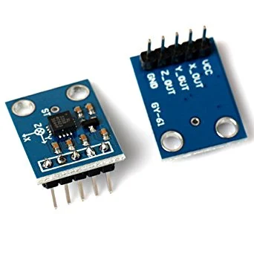
ADXL355-accelerometer sensor
The ADXL335 accelerometer is a compact, low-power device capable of detecting and measuring acceleration along three axes (X, Y, and Z). When used for recording seismic data, it can capture ground vibrations and help monitor seismic events.
The ADXL335 measures acceleration in three axes (X, Y, Z) within a range of ±3g.
It provides analog voltage outputs proportional to the acceleration for each axis.
These outputs can be read by a microcontroller (e.g., Arduino) with an Analog-to-Digital Converter (ADC) to digitize the signal for processing.

Slide 10
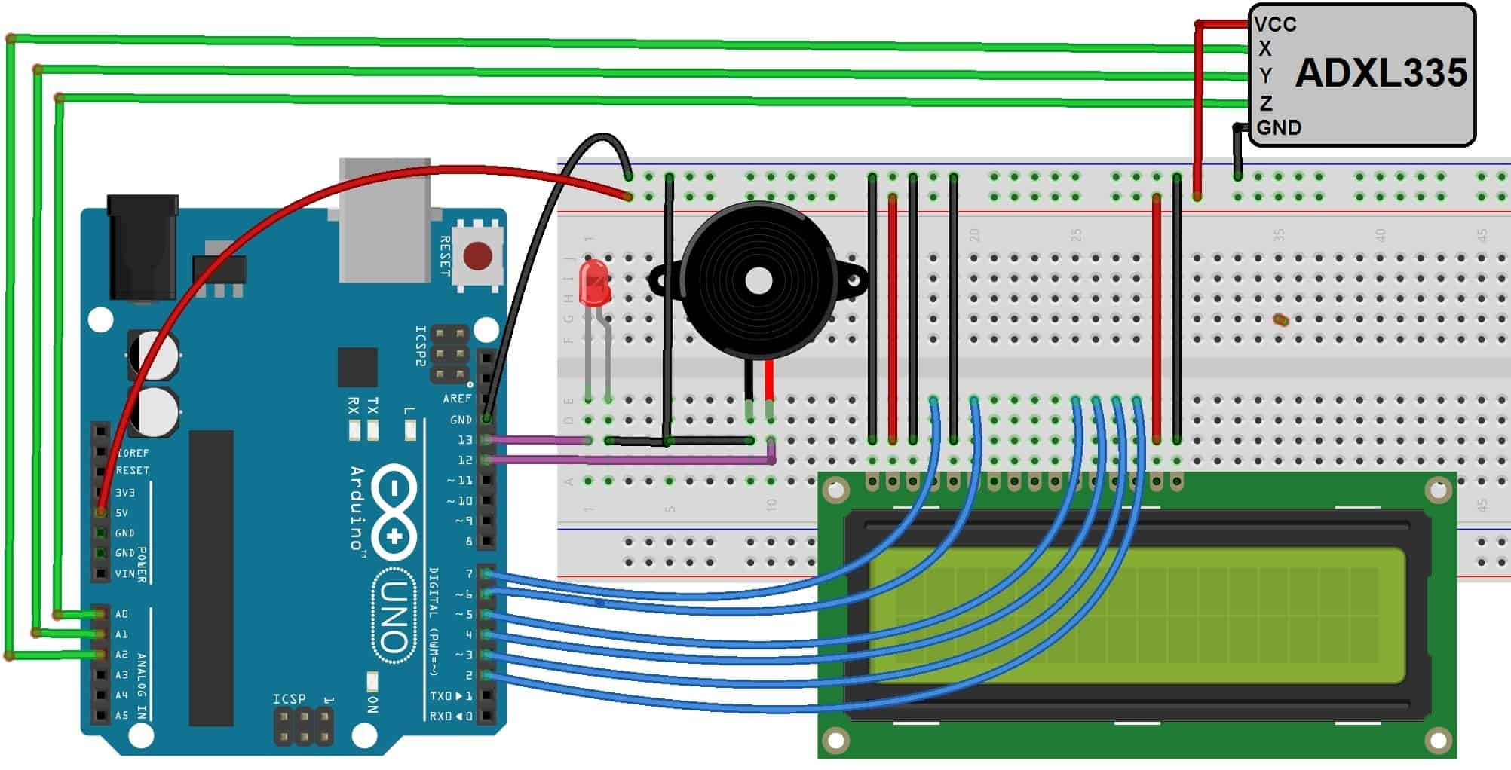
Circuit Diagram & Connections

Slide 11
BENEFITS :
Improved Safety.
Early Warning.
Awareness and Preparedness.
infrastructure and Asset Protection.
Cost-Effective Solution.
Real-Time Monitoring.
Portability.
Potential for Further Development

Slide 12
Conclusion
The earthquake detector project successfully demonstrated a low-cost, efficient system for detecting seismic activity using an accelerometer, activating an alarm, and plotting real-time seismic data. By utilizing an accelerometer as the primary sensor, the system can detect even minor ground vibrations and determine when they surpass a predefined threshold, triggering an alert. This approach can serve as a preliminary warning system in earthquake-prone areas or as an educational tool to help understand earthquake mechanics

